Slide 1
NIEM models
Webb Roberts <webb.roberts@gtri.gatech.edu> 2020-9-17

Slide 2
A niem model represents niem data definitions as niem data
NIEM data definitions in XML Schema maintain a conceptual model.
<Person>
<HairColor>Brown</HairColor>
</Person>
Person
A Person
HairColor
Brown
instance of
element
Person
complex type
PersonType
element
HairColor
complex type
HairColorType
represents
Property
Class
Property
Class

Slide 3
niem needs to use models many ways
Spreadsheets
XML Schema
Documentation
API Specification
JSON Schema

Slide 4
niem models are a common representation for niem data definitions
Tools
Spreadsheets
Documentation
UML
NIEM Model
API Specification
RDFS/OWL
XML Schema
JSON Schema

Slide 5
NIEM data models are represented as niem data
Provides a technology-independent representation of NIEM data models
Work with NIEM models however you work with NIEM data or data definitions
NIEM data models are plain NIEM data
XML, JSON, RDF, etc.
Supports technology-specific representations
XML Schema, RDFS/OWL, JSON Schema, UML, etc.
Use free & open-source tools, or COTS tools to manage NIEM data models

Slide 6
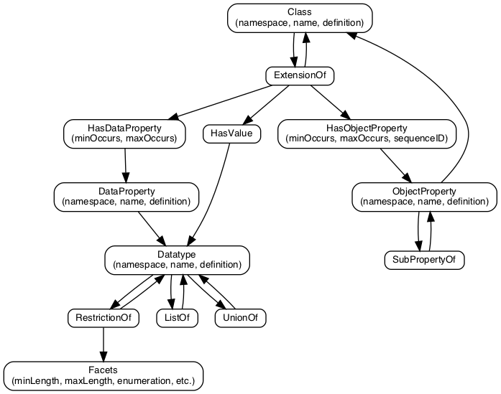
The NIEM Metamodel
Defines NIEM models
Represented as a NIEM model
Expressed as NIEM XML
Can be transformed into XML Schema, JSON, etc.

Slide 7
NTAC Activity
Developed
A draft metamodel, represented as NIEM XML
A model-to-XML Schema translator
Future work
Add full Reference Schema requirements to metamodel and XML Schema translator
Develop additional translators, including
Develop model-to-JSON Schema translator
Develop NIEM Schema-to-Model translator
Develop UML-to-Model-to-UML translator
Develop specifications
NIEM Model Specification
NIEM XML Specification, simpler than the NIEM NDR

